Slide 1
Regular Expression
Course Code:CSC3220
Course Title: Compiler Design
Dept. of Computer Science
Faculty of Science and Technology
Lecturer No: |  | Week No: |  | Semester:
Lecturer: | Md Masum Billah, billah.masumcu@aiub.edu

Slide 2
Lecture Outline
Definition of a Regular Expression
Rules of a Regular Expression
Examples
Exercises

Slide 3
Objectives and Outcomes
Objectives:
Understand the basic concept of Regular expression
Understand the regular expression algorithm
Outcome:
Students should be able to design the nondeterministic finite automate from regular expression.
Students should be able to know the applications of a regular expression.

Slide 4
Regular Expression
Definition: A sequence of symbols and characters expressing a string or pattern to be searched for within a longer piece of text.
Another words to say a regular expression is a method used in programming for pattern matching. Regular expressions provide a flexible and concise means to match strings of text.
The regular expressions are built recursively out of smaller regular expressions, using some rules.
Each regular expression r denotes a language L(r), which is also defined recursively from the languages denoted by r ' s subexpressions.

Slide 5
Regular Expression
The regular expressions are built recursively out of smaller regular expressions, using some rules.
Each regular expression r denotes a language L(r), which is also defined recursively from the languages denoted by r ' s subexpressions.

Slide 6
Rules of Regular Expression
Here are the rules that define the regular expressions over some alphabet £ and the languages that those expressions denote.
Basis
Induction
Precedence

Slide 7
Rules of Regular Expression
BASIS: There are two rules that form the basis:
E is a regular expression, and L(E) is {E}, that is, the language whose sole member is the empty string.
If a is a symbol in E, then a is a regular expression, and L(a) = {a}, that is, the language with one string, of length one, with a in its one position. Here italics is used for symbols, and boldface for their corresponding regular expression.

Slide 8
Rules of Regular Expression
INDUCTION: There are four parts to the induction. Suppose r and s are regular expressions denoting languages L(r) and L(s), respectively.
(r)|(s) is a regular expression denoting the language L(r) U L(s).
(r)(s) is a regular expression denoting the language L(r)L(s).
(r)* is a regular expression denoting (L(r))*.
(r) is a regular expression denoting L(r).The last rule says that we can add additional pairs of parentheses around expressions without changing the language they denote.

Slide 9
Example of a Regular expression
Let E = {a, b}.
1. The regular expression a|b denotes the language {a, b}.
2. (a|b)(a|b) denotes {aa, ab, ba, bb}, the language of all strings of length two over the alphabet E.
Another regular expression for the same language is aa|ab|ba|bb.
3. a* denotes the language consisting of all strings of zero or more a's, that is, { E, a , a a , a a a , . . . }.

Slide 10
Example of a Regular expression
Let E = {a, b}.
4. (a|b)* denotes the set of all strings consisting of zero or more instances of a or b, that is, all strings of a's and b's: {E ,a, b,aa, ab, ba, bb,aaa,...}.
Another regular expression for the same language is (a*b*)*.
a|a*b denotes the language {a, b, ab, aab, aaab,...}, that is, the string a and all strings consisting of zero or more a's and ending in b.

Slide 11
Operations of a Regular expression
Operations:
The various operations on languages are:
Union of two languages L and M is written as
L U M = {s | s is in L or s is in M}
Concatenation of two languages L and M is written as
LM = {st | s is in L and t is in M}
The Kleene Closure of a language L is written as
L* = Zero or more occurrence of language L.

Slide 12
Nondeterministic Finite Automata(NFA)
An NFA can be represented by a 5-tuple (Q, ∑, δ, q0, F) where
Q is a finite set of states.
∑ is a finite set of symbols called the alphabets.
δ is the transition function where δ: Q × ∑ → 2^Q
q0 is the initial state from where any input is processed (q0 ∈ Q).
F is a set of final state/states of Q (F ⊆ Q).

Slide 13
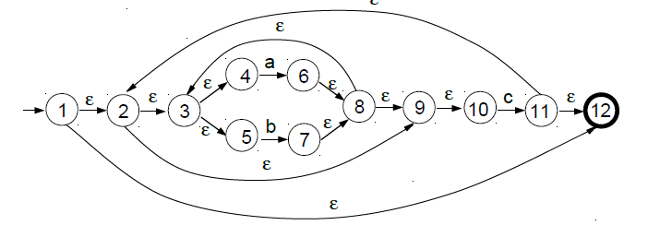
Regular Expression To NFA
Outline the NFA generated by the construction of Thompson relevant to the following regular expression:
Example: ((a | b)*c)*

Slide 14
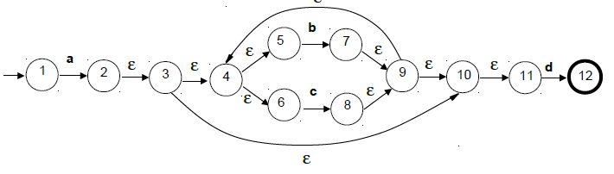
Regular Expression To NFA
By means of the construction of Thompson, outline the NFA relevant to the following regular expression:
Example: a (b | c)*d

Slide 15
Regular Expression To NFA
By means of the construction of Thompson, outline the NFA relevant to the following regular expression:
Example: a (b | c)*d

Slide 16
Class Exercises
(aUb)*abc
(abUbc(abUc)*)*

Slide 17
Lecture References
A. Aho, R. Sethi and J. Ullman, Compilers: Principles, Techniques and Tools
(The Dragon Book), [ Second Edition]

Slide 18
References
A. Aho, R. Sethi and J. Ullman, Compilers: Principles, Techniques and Tools(The Dragon Book), [ Second Edition]
Principles of Compiler Design (2nd Revised Edition 2009) A. A. Puntambekar
Basics of Compiler Design Torben Mogensen

